Slide 1
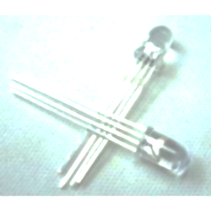
RGB LED Lab
Marc Lichtman

Slide 2
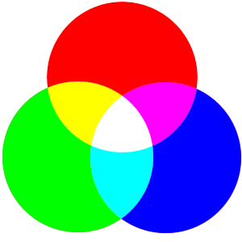
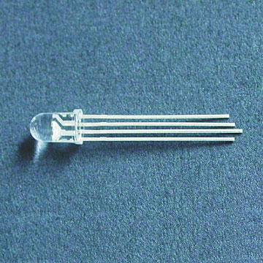
What is an RGB LED?
LED with three separate LEDs inside of it
Red, green, blue
You can make any color
Use PWM to change the brightness

Slide 3
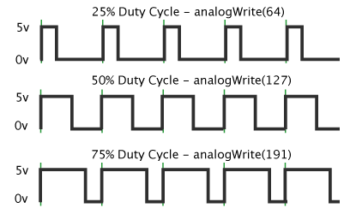
What is PWM?
Pulse Width Modulation
Generates square wave
Frequency = 500 Hz for Arduino
500 Hz = period of 2 milliseconds
We feed an LED with a PWM signal to make it dim
Duty cycle is what we call the percent of on time (ex: 25% duty cycle)

Slide 4
analogWrite()
analogWrite(pin, value);
//pin- the pin to write to
//value- the duty cycle: between 0 (always off) and 255 (always on)

Slide 5
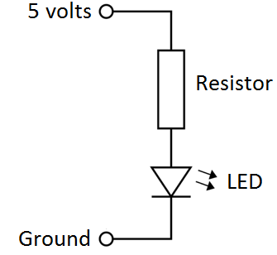
Current Limiting Resistors
LEDs will draw a huge amount of current if you let them
V=IR does not work with LEDs
A resistor in series of the LED will allow you to use V=IR
If we use a 1k ohm resistor
V = IR → 5 = I*1000 → I = 5 milliamps
5 milliamps is a good amount of current for an LED

Slide 6
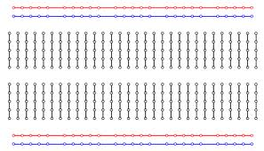
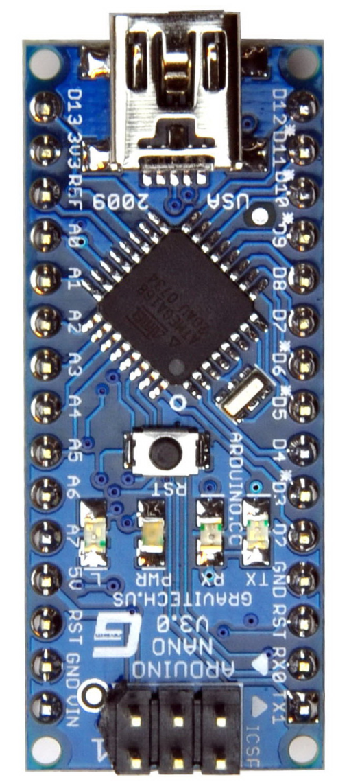


Schematic
1k Ω
Resistors
LED
Longest Pin
---Steps---
Connect Longest LED pin to GND
Connect other three to resistors
Connect other side of resistors to pins D11, D10, D9
Test your code to figure out which pin is which color

Slide 7
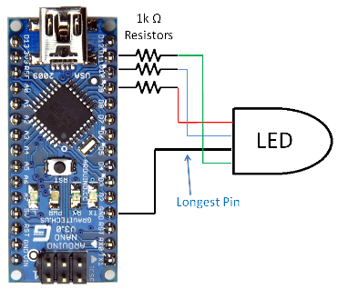

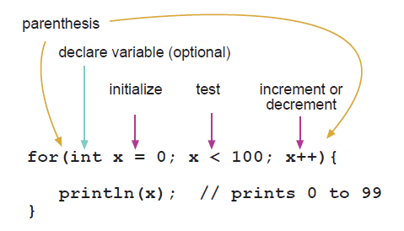
Code
D9 D10 D11
For Advanced Students
Challenges:
Make the colors fade in and out
Control color with your laptop
If you need help use
http://arduino.cc/en/Reference
GND
GLOBAL VARIABLES- PUT BEFORE setup()
int red = 11;
int green = 10;
int blue = 9;
PUT INSIDE OF setup()
pinMode(red, OUTPUT); // sets the pin as output
pinMode(green, OUTPUT);
pinMode(blue, OUTPUT);
PUT INSIDE OF loop()
analogWrite(green, 113); //sets green LED to a level of 113 (we can use anywhere from 0 – 255)
delay(10);

